Slide 1


Predictive Analysis on Sales_Data
Group16 – Decision Science Capstone Project
Members:
Anuradha Vyas – Teaching in Tertiary Education
Fawaz Majeed- IT Manager, Luxury Fashion Industry
Kanchan Kanojia – Automated Testing across various industries

Slide 2
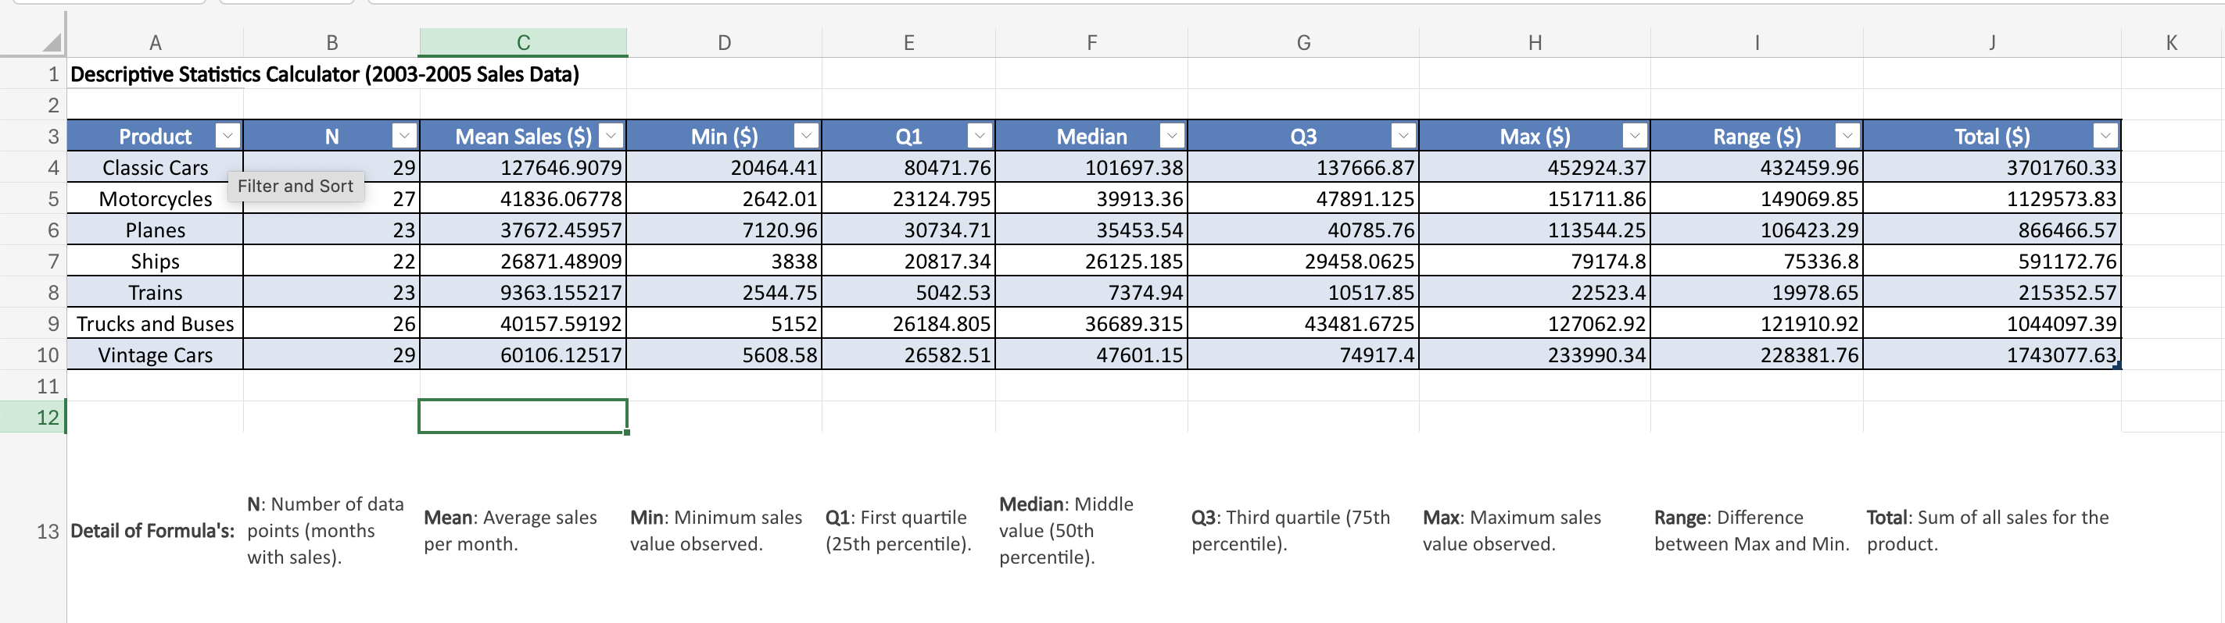
Descriptive Analysis (All Products)
Notes:
Kanchan

Slide 3
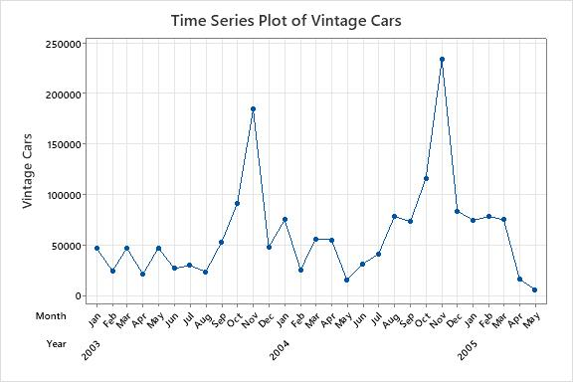
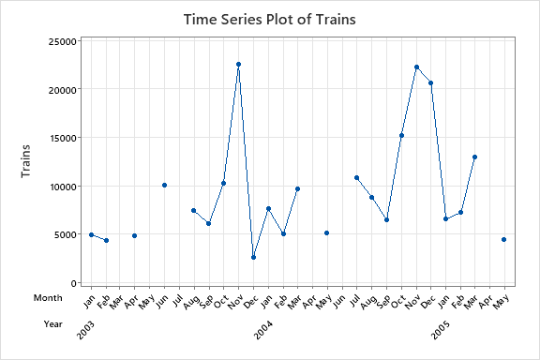
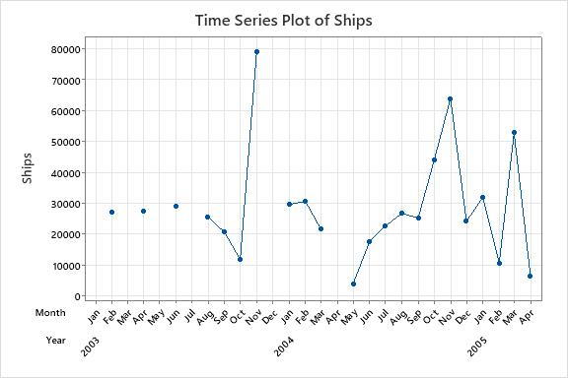
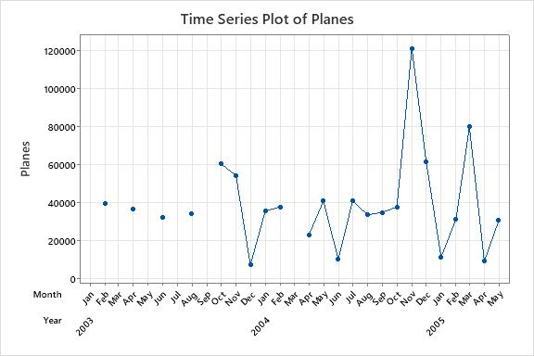
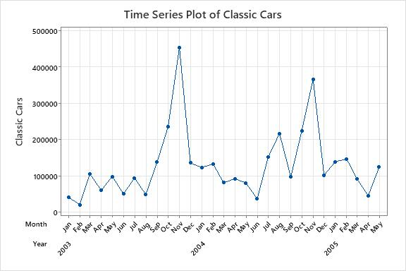
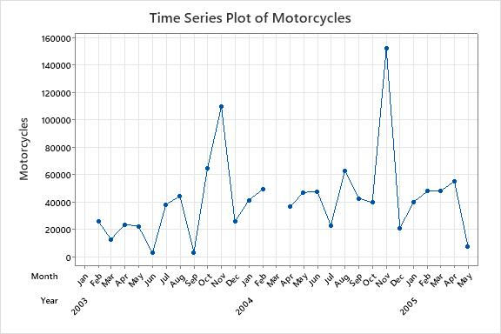
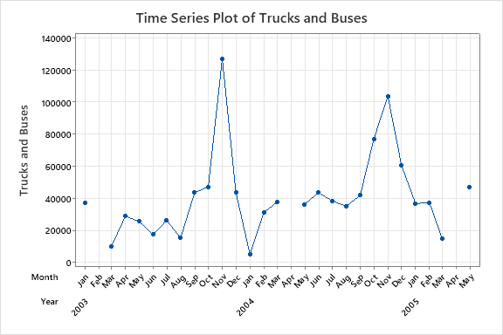
TREND? SEASONALITY?
Notes:
Kanchan

Slide 4
Tools Used / Solver Optimization
Excel / Minitab
Descriptive analysis
Restructure and preprocessing
Solver to identify optimized weight and alpha value
Quick validation
Python
Generic reusable model across products.
Utilized opt value from excel solver.
RMSE Heat map evaluation.
To Plot actual vs Prediction for result visualization
Export of final data to result excel.
 | Weightages (WMA)
 | W1 | W2 | W3
Optimised by Solver model | 0.00 | 0.30 | 0.70
Alpha (Exp Smoothening)
0.44
Notes:
Fawaz

Slide 5
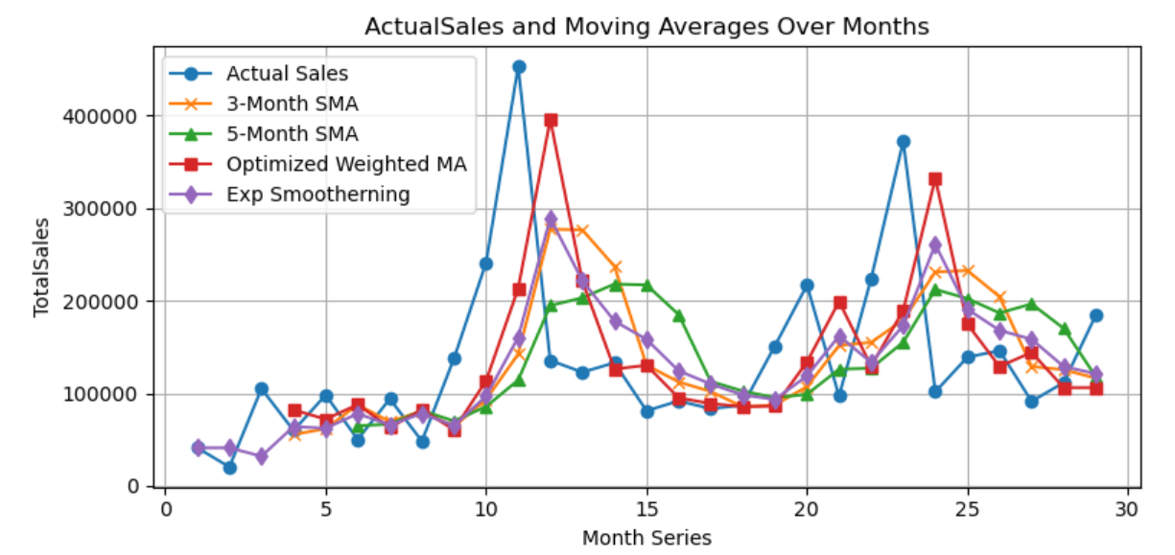
Moving Average & Exp Smoothing Predictions
Notes:
Fawaz

Slide 6
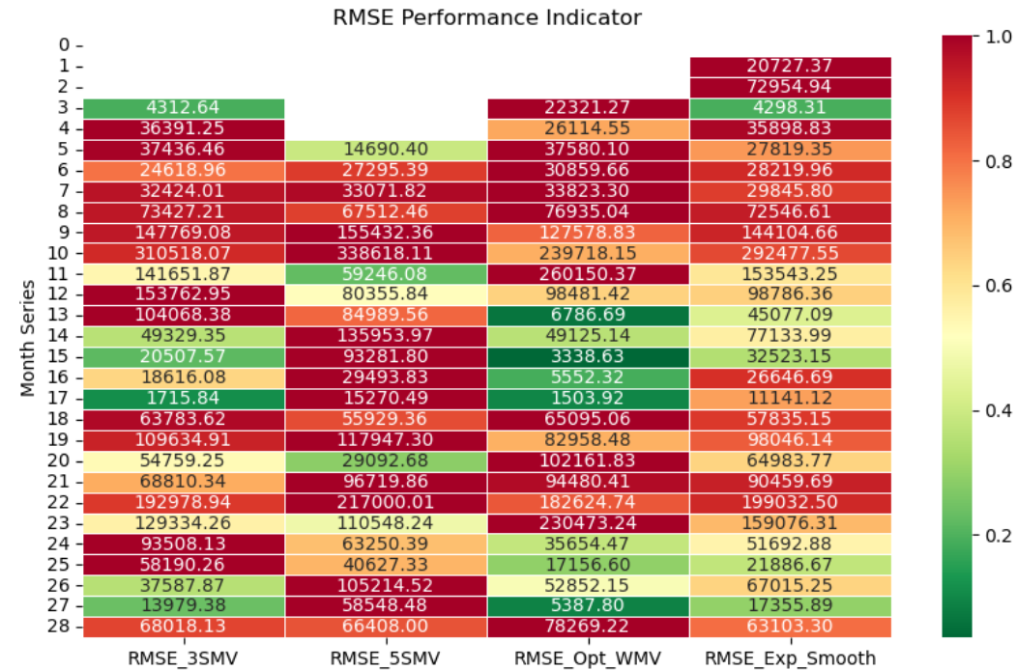
RMSE Comparison
Method | RMSE
RMSE_3MA | 63300.70
RMSE_5MA | 73481.34
RMSE_WMV | 60652.33
RMSE_WMV_OPT | 58302.42
RMSE_EXP_SMOOTH | 96779.97
Notes:
Fawaz

Slide 7
Holt’s and Winter’s Models (optimized weights)
 | Alpha opt | Beta opt | Gamma opt
Winter’s | 0.37 | 0.43 | 0.20
Holt’s | 0.28 | 0
Notes:
Fawaz

Slide 8
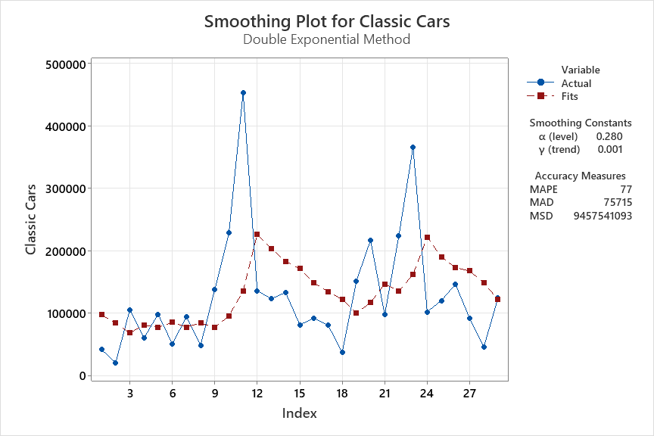

Slide 9
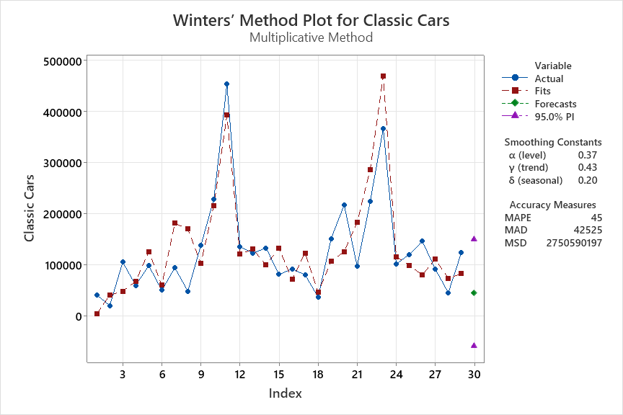

Slide 10
Conclusion
As the data does not show evidence of trend and the size is not large enough to confirm the seasonality, it is best to go for the prediction made using the weighted Moving averages.
Predicted Sales for all Products For June 2005
Classic Cars | 100304.236​
Motorcycles | 48579.23074​
Planes | 9036.058791​
Ships | 10628.11323​
Trains | 1310.88464​
Trucks and Buses | 19111.54341​
Vintage Cars | 8733.31935​

Slide 11


